Slide 1
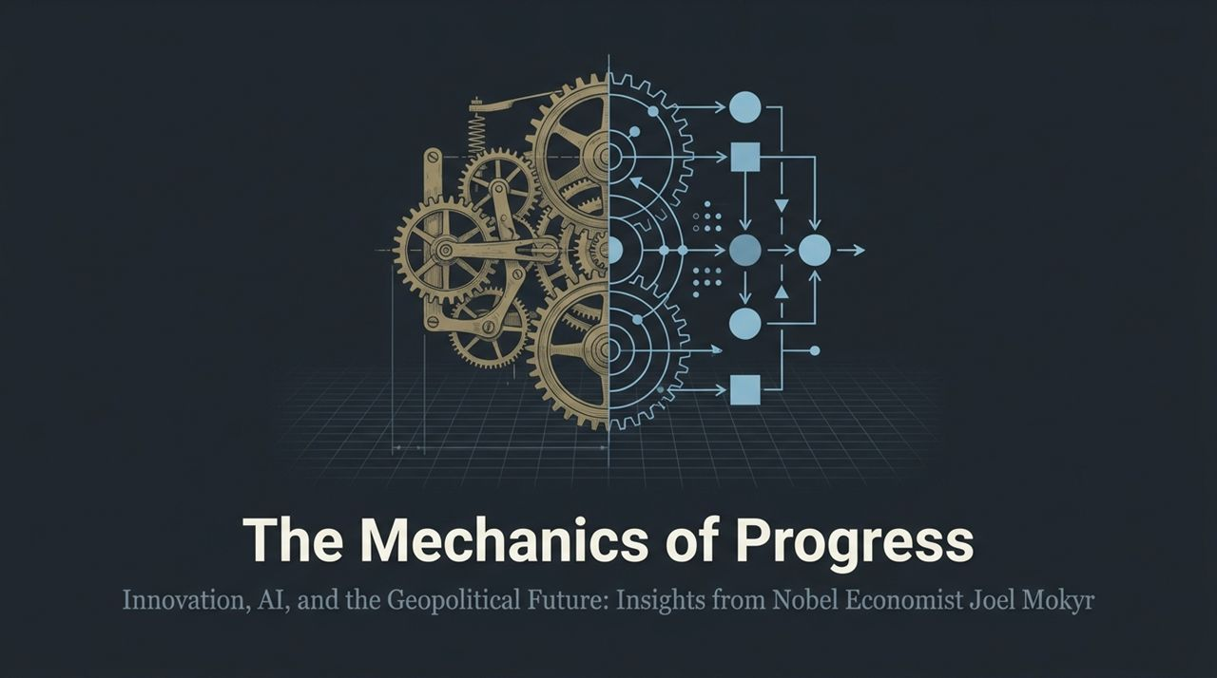
Notes:
Good morning/afternoon, everyone. Today’s presentation, The Mechanics of Progress: Innovation, AI, and the Geopolitical Future, explores one of the most fundamental questions in modern economics: Why did humanity experience sustained economic growth after millennia of stagnation, and what does that history tell us about our AI-driven future?
This presentation synthesizes key historical and economic frameworks developed by Nobel Laureate Joel Mokyr, co-winner of the 2025 Nobel Prize in Economics, alongside Philippe Aghion and Peter Howitt.
As we stand at an inflection point defined by artificial intelligence, rising geopolitical rivalry, and institutional friction, looking at the mechanical levers of historical progress is essential.
Over the next 16 slides, we will examine Cardwell’s Law, the cultural origins of the Industrial Revolution, the reality behind AI panic, the return of Gilded Age wealth concentration, and how superpowers—particularly the US and China—will navigate the mid-21st century.
Nobel Economist: Will China Eventually Overtake America? | Joel Mokyr
https://www.youtube.com/watch?v=rgXIJz0WvBE

Slide 2
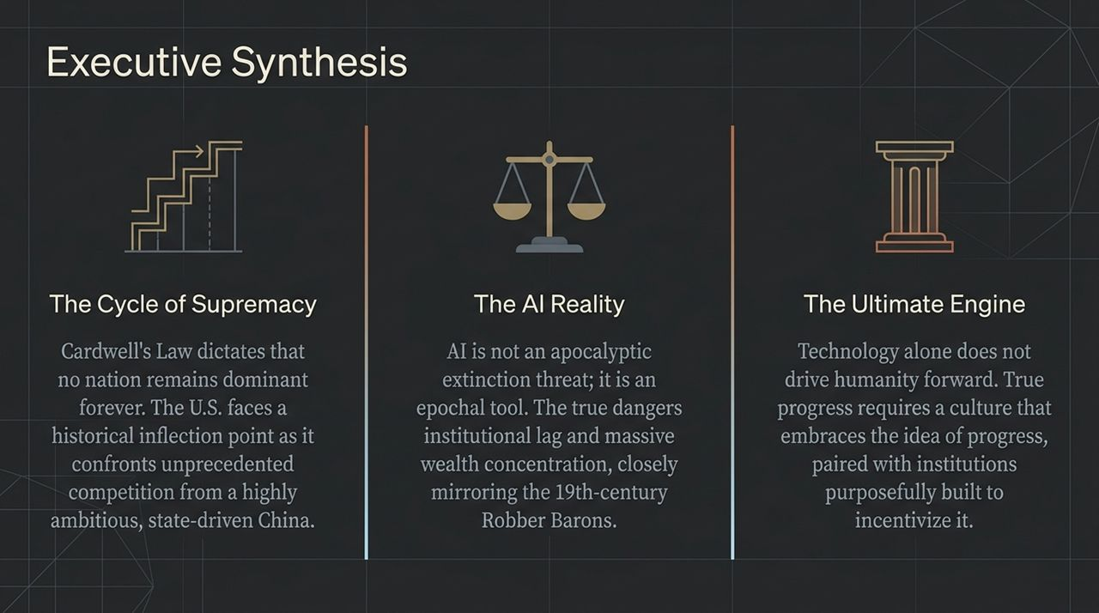
Notes:
To frame our discussion today, Slide 2 provides an executive synthesis across three core dimensions:
The Cycle of Supremacy: First, Cardwell’s Law reminds us that technological leadership is never permanent. The United States, which dominated the 20th century, now confronts an ambitious, state-driven model in China.
The AI Reality: Second, AI is not an existential doom threat that will wipe out humanity. The true threat lies in institutional lag—where fast technology leaves slow democratic governance behind, driving extreme wealth concentration reminiscent of 19th-century Robber Barons.
The Ultimate Engine: Third, technology alone doesn't create progress. Sustained growth requires a culture of growth—a societal belief that tomorrow can be better than today—paired with institutional incentives like temporary patent systems that reward innovation.

Slide 3
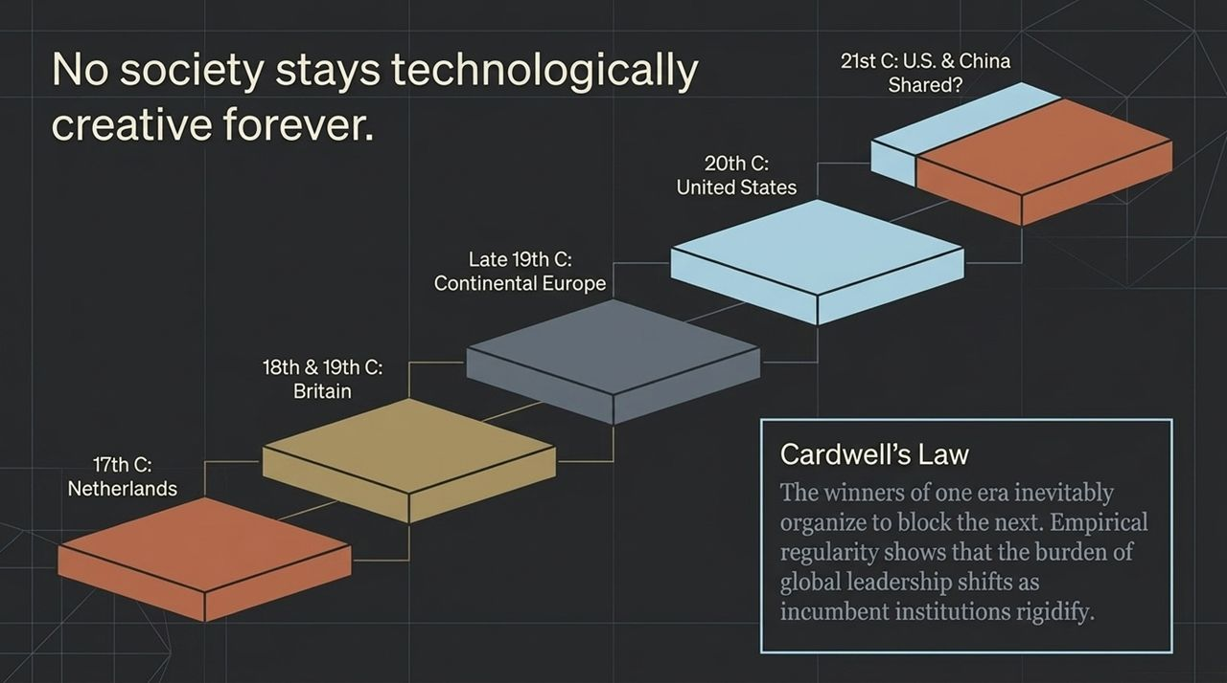
Notes:
Let’s dive into Cardwell’s Law, named after historian of technology Donald Cardwell. The empirical law states: No nation stays technologically creative forever.
Why does this happen? Because the 'winners' of one generation inevitably build rigid incumbent institutions to block the innovations of the next generation.
Look at the historical trajectory on this slide:
17th Century (The Netherlands): Led maritime and commercial innovation.
18th & 19th Century (Britain): Began the Industrial Revolution, but lost its edge as continental rivals adapted.
Late 19th Century (Continental Europe): Germany and France led in chemicals and steel.
20th Century (United States): Dethroned Europe, turbocharged by fleeing European talent during two world wars.
Now, in the 21st century, we arrive at a critical question: Will the U.S. maintain its lead, or will it be forced to share global leadership—or even cede it—to China?

Slide 4
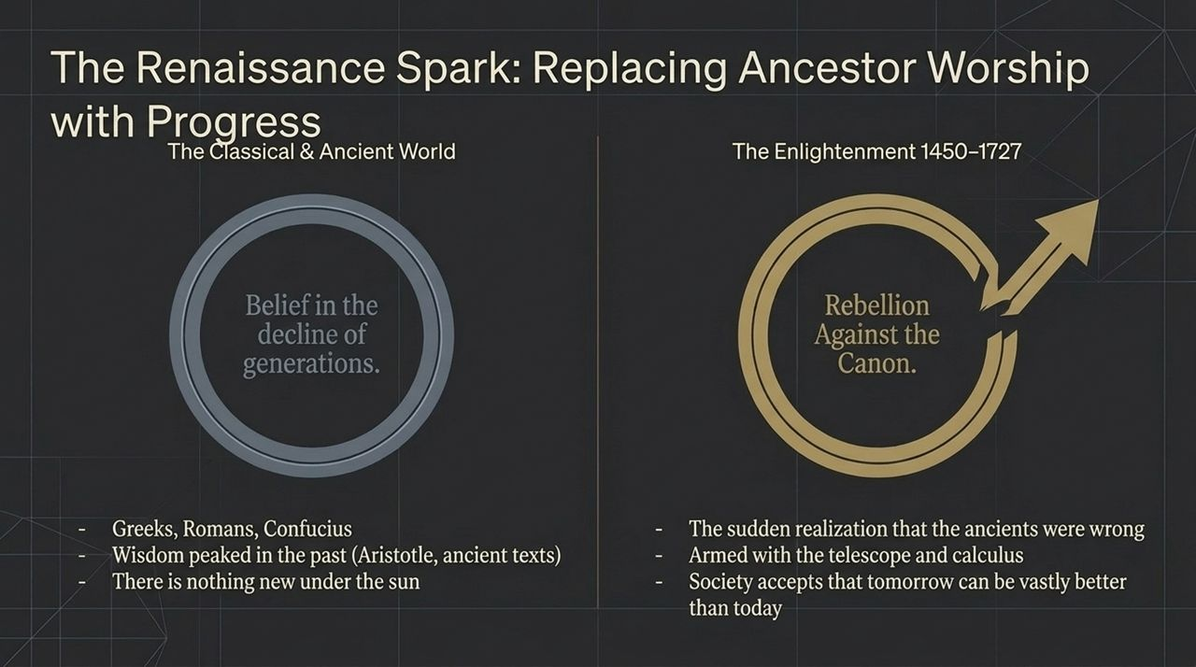
Notes:
To understand why progress happened, we must understand why it didn't happen for thousands of years.
In classical and ancient times—across Greek, Roman, and Confucian civilizations—society held a belief known in Hebrew as Yeritath HaDorot or the 'decline of generations'.
The assumption was simple: wisdom peaked in the past. Aristotle, Galen, Confucius, or sacred texts held all essential knowledge. As the book of Ecclesiastes famously stated, 'There is nothing new under the sun.'
If you believe the ancients knew everything and that human intellect decays over time, you do not invest in innovation or question traditional canons.

Slide 5
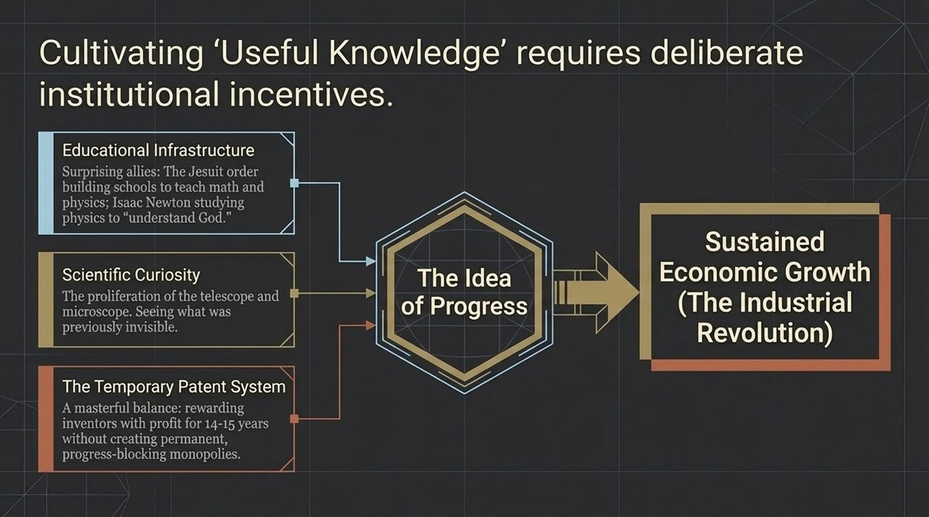
Notes:
The turning point occurred during the early modern era (1450–1727), bookended by Gutenberg's printing press and Newton's death.
For the first time in human history, intellectuals staged a rebellion against the canon. Armed with tools like the telescope and microscope, thinkers realized that Aristotle and the ancients were simply wrong about how the physical world worked.
Instead of worshipping the past, European culture embraced the notion that modern humans knew more than the ancients. Society adopted a revolutionary premise: tomorrow can be vastly better than today.

Slide 6
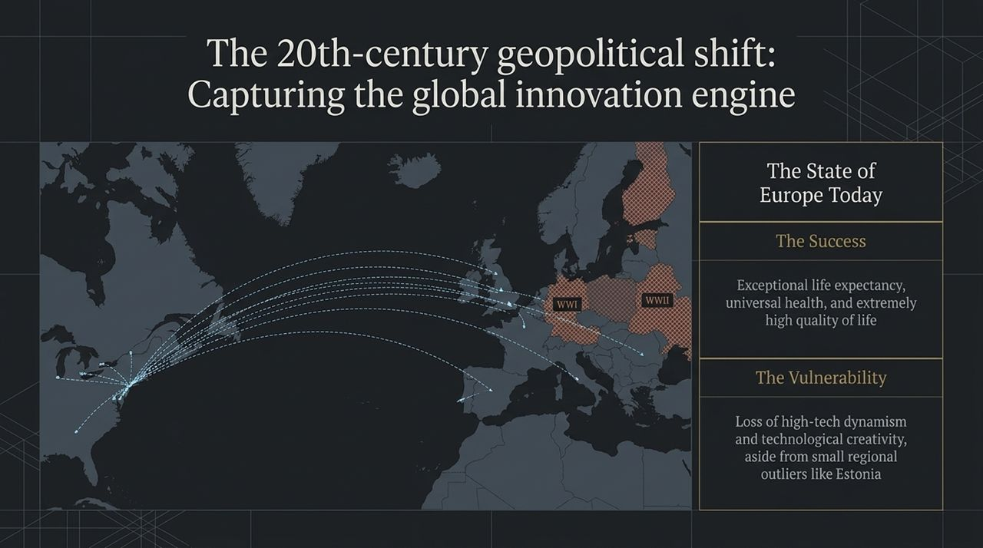
Notes:
Slide 6 explicitly contrasts these two worldviews:
Classical & Ancient World: Belief in generational decline; wisdom is anchored in Aristotle, ancient scripture, and Confucius; belief that novel ideas are impossible or dangerous.
Enlightenment (1450–1727): Rebellion against the canon; equipped with calculus and observational tools; societal acceptance of progress as desirable and achievable.
Once this mental model took root around 1700, philosophers wrote an explicit agenda to cultivate what they termed 'useful knowledge'.

Slide 7
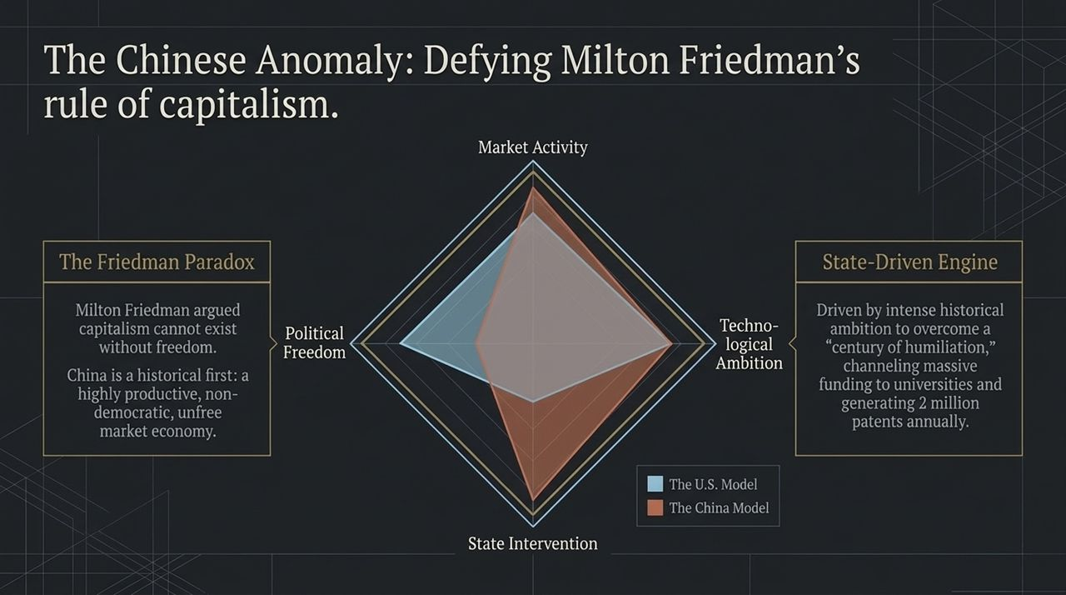
Notes:
Believing in progress isn't enough; you need institutional mechanics to incentivize it.
Slide 7 outlines three key mechanisms:
Educational Infrastructure: Surprising historical actors played key roles—such as the Jesuit order building schools to teach physics and math, or Isaac Newton studying physics to 'understand God'.
Scientific Curiosity: Inventions like the telescope and microscope made the invisible visible, expanding human inquiry.
The Temporary Patent System: Perhaps the single greatest institutional innovation. By granting inventors a temporary monopoly (14–15 years), society incentivized technological risk-taking without creating permanent progress-blocking monopolies.
This combination produced sustained economic growth, launching the Industrial Revolution after 1800.

Slide 8
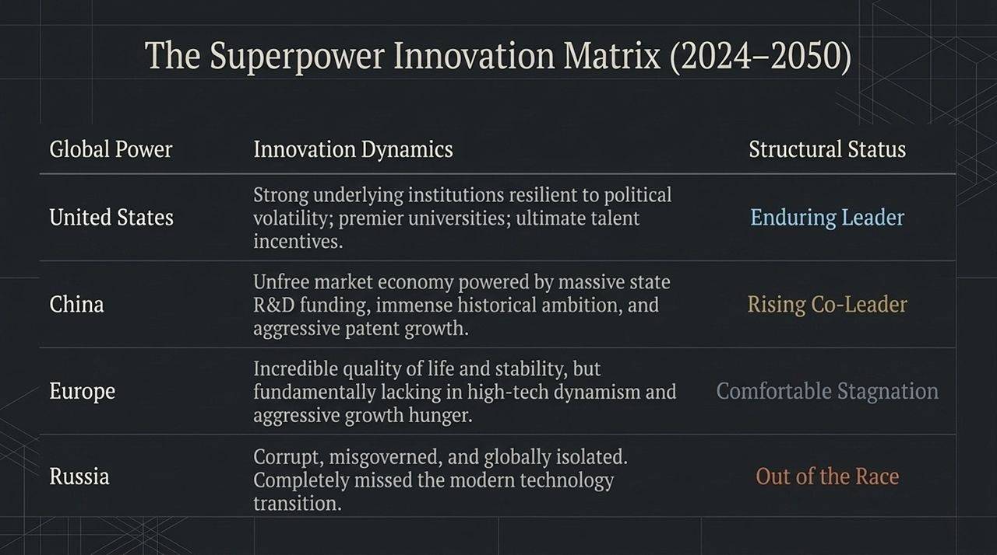
Notes:
During the 20th century, the United States captured the global innovation engine from Europe.
Two World Wars devastated Europe's physical and human capital, causing an unprecedented flight of scientists, artists, and engineers to American shores.
Where does Europe stand today?
The Success: Exceptional quality of life, universal healthcare, and high life expectancy—living 3 to 4 years longer on average than Americans.
The Vulnerability: Loss of high-tech dynamism and technological ambition, outside of small regional outliers like Estonia.

Slide 9
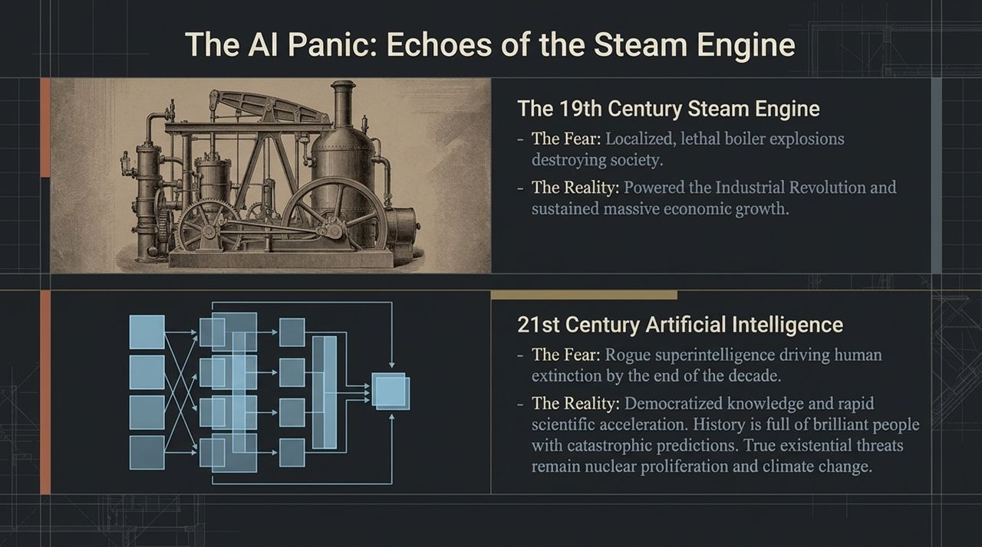
Notes:
Slide 9 addresses The Chinese Anomaly. For decades, economists following Milton Friedman asserted that free-market capitalism could not exist without political freedom.
China defies this paradigm. It is an unfree, nondemocratic state that nevertheless operates a dynamic market economy.
Driven by intense historical ambition to overcome its 'century of humiliation', China operates a massive state-driven innovation engine:
Funneling billions into university scientific research.
Generating over 2 million patents annually.
Dominating advanced journals in medicine, engineering, and materials science.

Slide 10
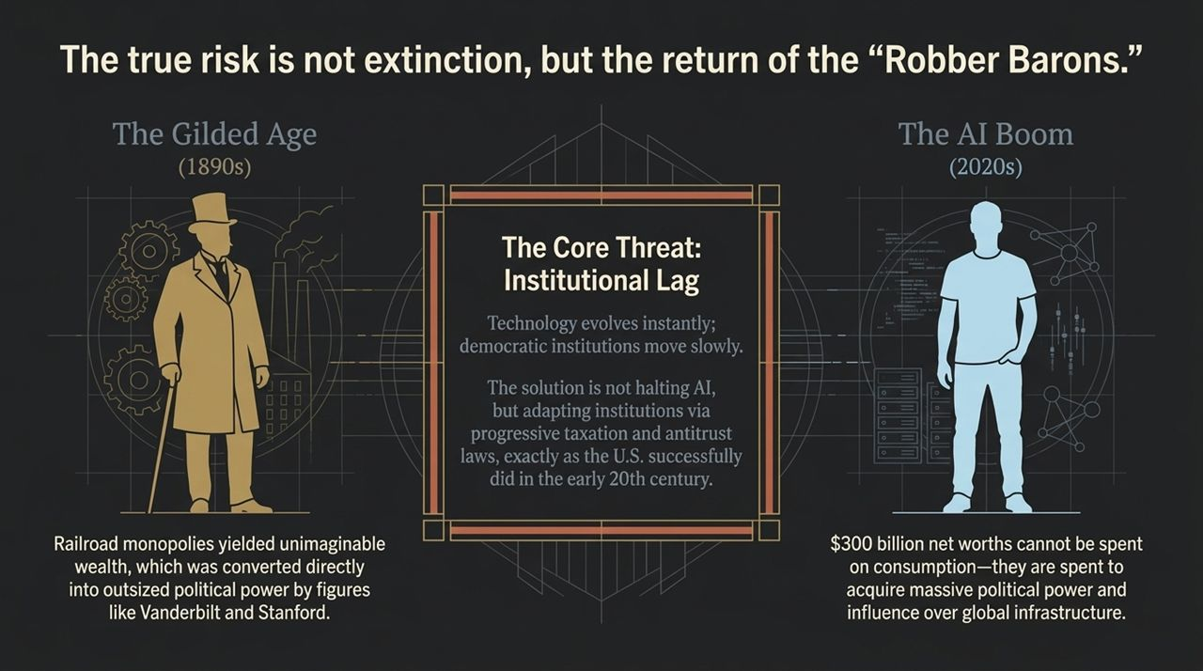
Notes:
Looking ahead from 2024 to 2050, Slide 10 categorizes four global power blocs:
United States (Enduring Leader): Resilient institutions, world-class universities, high talent attraction, though facing internal political volatility.
China (Rising Co-Leader): Powered by aggressive state R&D funding, immense historical drive, and vast engineering capacity.
Europe (Comfortable Stagnation): High quality of life, but fundamentally lacking the hunger and risk tolerance for high-tech scale.
Russia (Out of the Race): Corrupt, misgoverned, and isolated; completely missed the modern digital and tech transition.

Slide 11
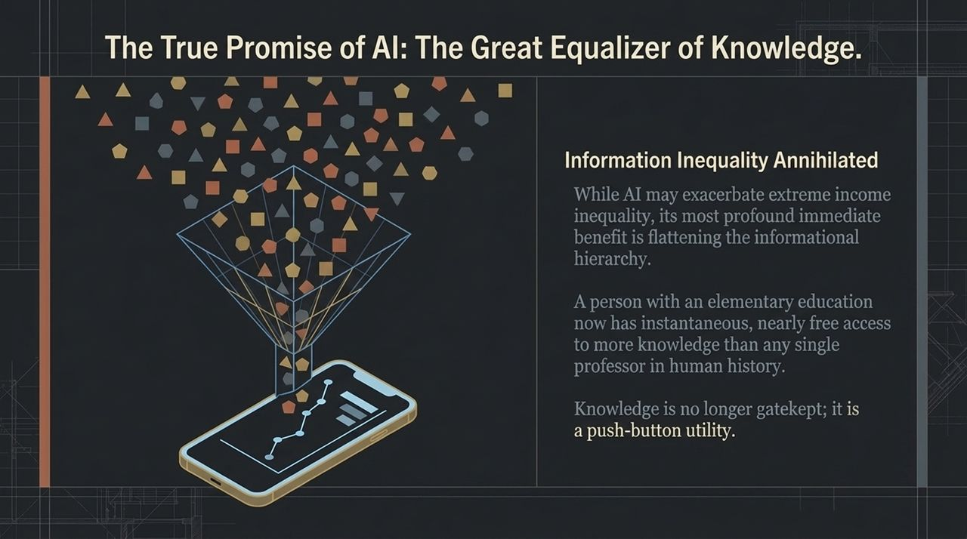
Notes:
Now let's address the narrative surrounding Artificial Intelligence. Today, we hear doomsday claims from researchers and tech executives that AI could 'kill all humans by the end of the decade'.
As economic historians, we've seen this movie before:
19th Century Steam Engine: Feared due to localized boiler explosions. In reality, it powered the Industrial Revolution.
21st Century AI: Feared as a rogue superintelligence causing extinction. In reality, history is full of smart people with catastrophic predictions.
The true existential physical threats remain nuclear proliferation (which has existed since the 1950s) and climate change—not rogue AI software.

Slide 12
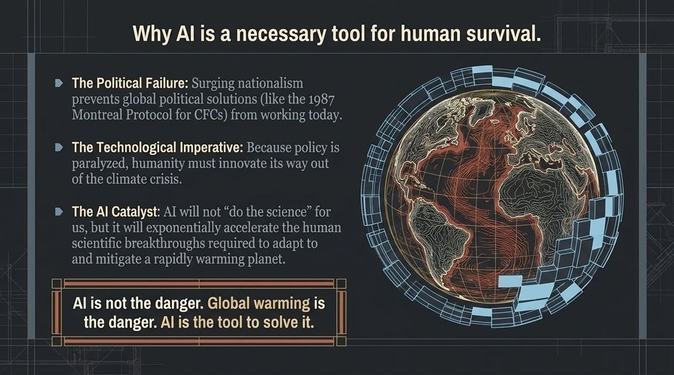
Notes:
If extinction isn't the primary risk, what is? Institutional Lag and the return of the Gilded Age Robber Barons.
In the late 19th century, transcontinental railroad monopolies created unheard-of wealth for figures like Vanderbilt, Stanford, and Harriman. Today, tech oligarchs amass net worths exceeding $300 billion.
You cannot spend $300 billion on personal consumption—you can only buy four houses, five cars, and eat three meals a day. Beyond that, excess wealth converts directly into outsized political power and global infrastructure control.
The solution isn't halting AI development; it's reforming institutions via progressive taxation and antitrust enforcement—just as the U.S. successfully did during the Progressive Era.

Slide 13
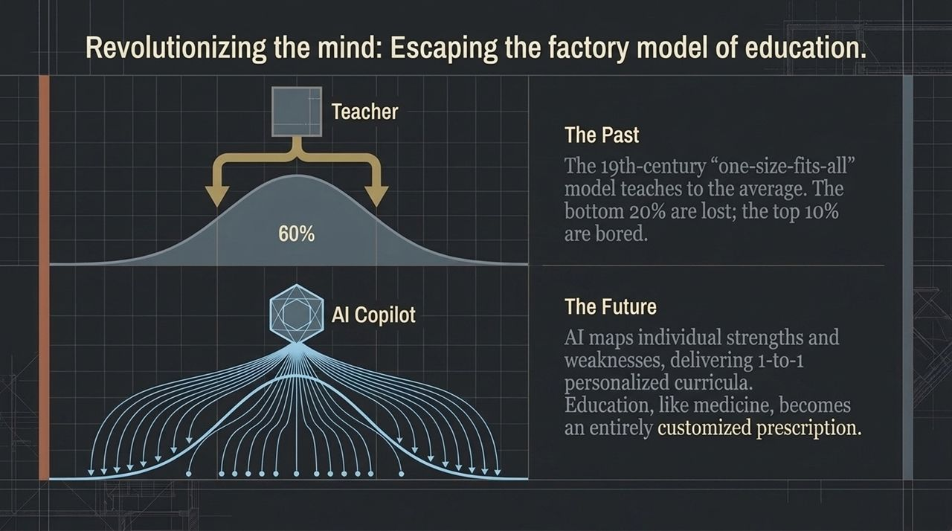
Notes:
While AI may worsen financial income inequality without proper tax reform, its greatest immediate gift is flattening informational inequality.
In the past, elite knowledge was gatekept by universities, professors, and expensive institutions.
Today, an individual with a basic education can open an AI copilot on a smartphone and instantly access more scientific, historical, and technical knowledge than any single scholar in human history.
Knowledge becomes an instant, low-cost utility for anyone with an internet connection.

Slide 14
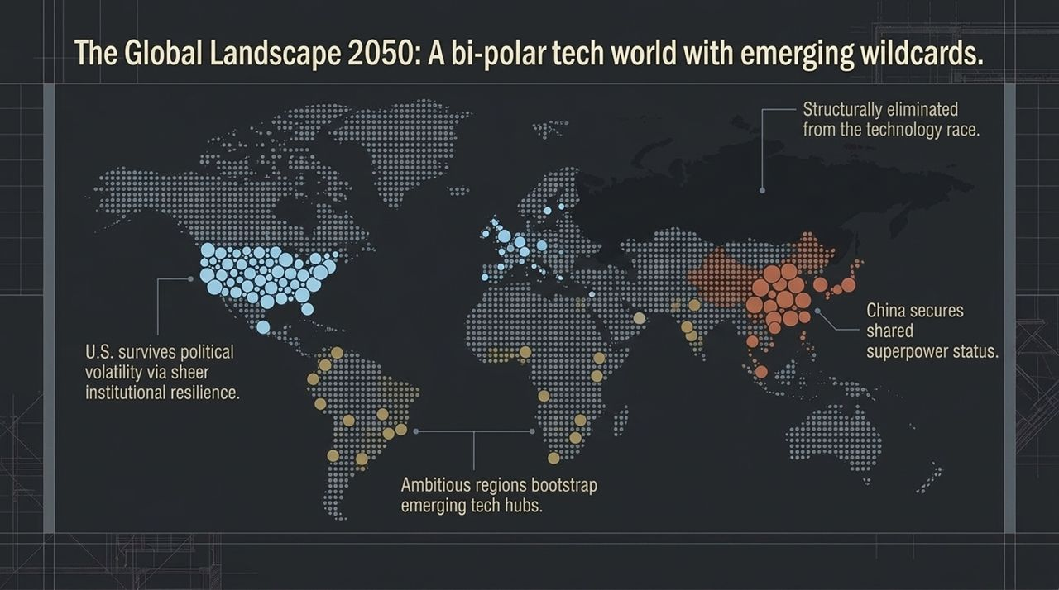
Notes:
Why is AI not just useful, but essential for human survival?
Because of rising global nationalism, international political cooperation on climate change (like the 1987 Montreal Protocol) is stalled.
Because policy is paralyzed, humanity's only way out of climate degradation is technological innovation.
AI will not 'do the science' by itself, but it acts as a force multiplier for human scientists—accelerating breakthroughs in materials science, clean energy, and carbon capture.
AI is not the danger; global warming is the danger. AI is our most powerful tool to solve it.

Slide 15
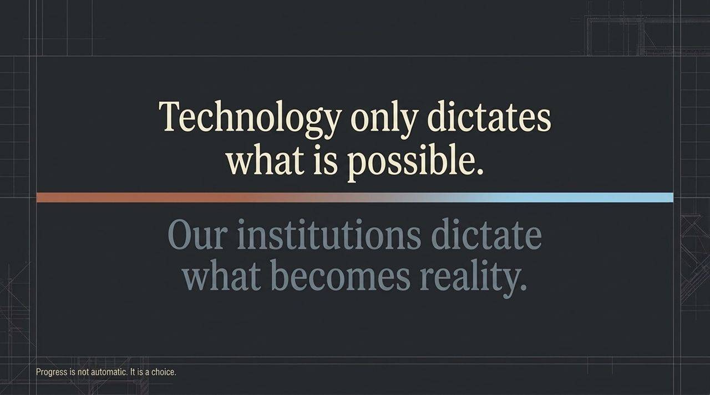
Notes:
Slide 15 highlights one of the most practical applications of AI: overhauling education.
Since the Industrial Revolution, education has operated on a 19th-century 'factory model'—one teacher lecturing to a bell curve of students. The bottom 20% are lost, the top 10% are bored, and instruction targets only the middle.
AI enables 1-to-1 personalized tutoring. It identifies a student's specific strengths, weaknesses, and learning styles in real time.
Just as medicine shifted from one-size-fits-all treatments to precision genomics, education will become a customized prescription for every individual mind.

Slide 16
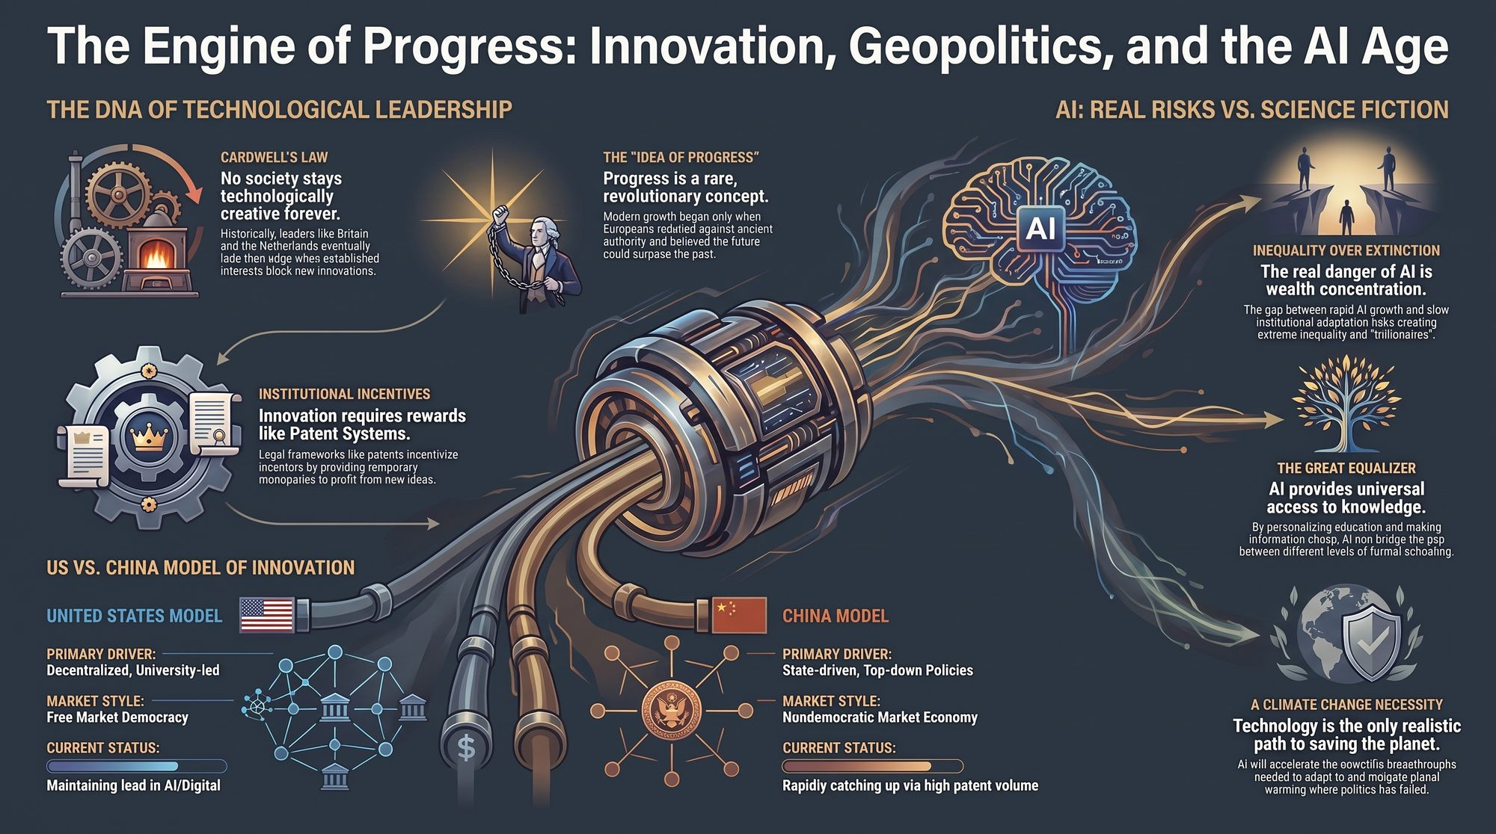
Notes:
To conclude our tour of The Mechanics of Progress, Slide 16 maps the global landscape toward 2050:
We are heading toward a bi-polar tech world anchored by the United States and China, with emerging wildcards in regions like Latin America or Southeast Asia.
Europe risks remaining in comfortable stagnation, while Russia remains structurally sidelined.
Let us leave you with this fundamental truth:
Technology only dictates what is possible.
Our institutions dictate what becomes reality.
Progress is not automatic, nor is it guaranteed by laws of nature. Progress is a conscious societal choice.
Thank you very much. I welcome any questions.
Nobel Economist: Will China Eventually Overtake America? | Joel Mokyr
https://www.youtube.com/watch?v=rgXIJz0WvBE

